Slide 1

Reducing Readmissions & Increasing PCP Visits After Discharge
Improving Discharge Planning & Quality of Clinical Care
An Analysis by GreatCare
Notes:
The subtitle can reflect our findings; match the description to the interventions we believe are most pertinent

Slide 2
The Basics
Further Segmentation
Deliverable/Intervention List
Overall & monthly under 30-day readmission rate (30RR): 11.27%
Overall & monthly under 7-day PCP visit after discharge (7PCPR): 30%
Considerations taken for calculations
30RR by attending provider & hospital
7PCR by individual PCP & group PCP
Common diagnoses & healthcare plans
Considerations taken for calculations
How to support Transition Care Managers
What data to explore further to aid in developing the most effective interventions.

Slide 3
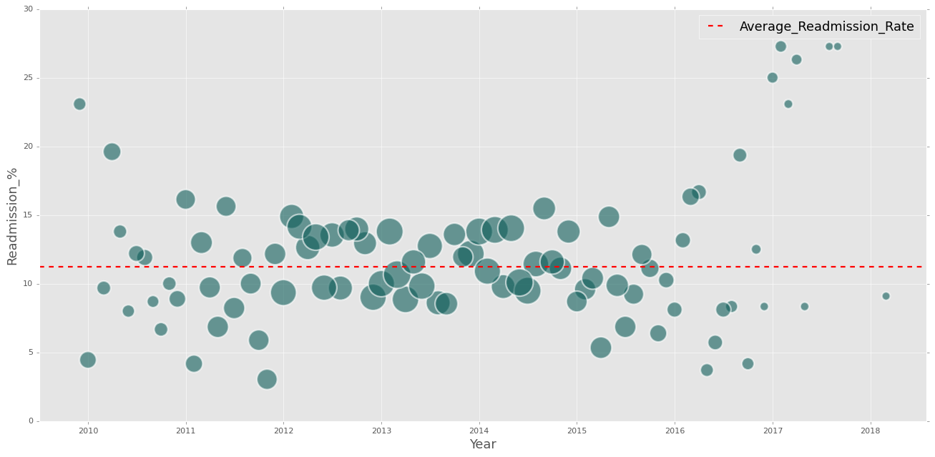
The Basics
OVERALL READMISSIONS RATE UNDER 30 DAYS: 11.27%
30RR (%) Over Time
Bubble size represents number of total hospital admissions per month
Only looked at months with more than 10 hospital admissions
Notes:
Based on this graph and the next one, recently, people are going back to the hospital rather than their PCP

Slide 4
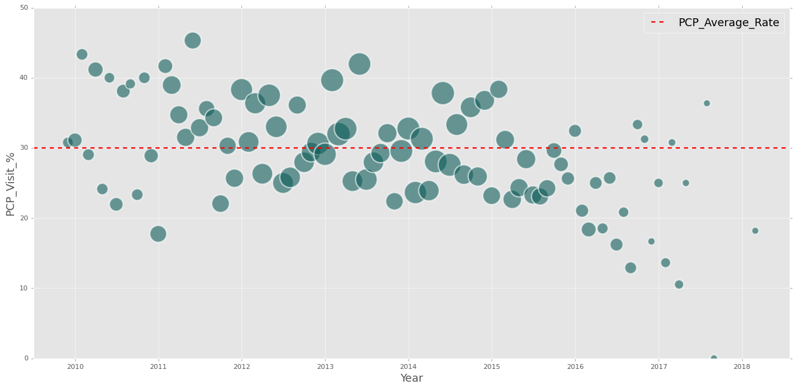
The Basics
OVERALL RATE OF PCP VISITS WITHIN 7 DAYS OF DISCHARGE: 30.0%
7PCPR (%) Over Time
Bubble size represents number of total hospital admissions per month
Only looked at months with more than 10 hospital admissions
Notes:
30% average rate for PCP visit within 7 days.
Bubble size is the count of hospital encounters.
There is a drop off in both hospital encounter count and percentage of pcp visits towards the later parts of the dataset.
Filtered out months with 10 or less hospital encounters.

Slide 5
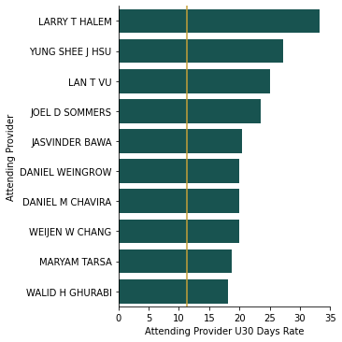
Further Segmentation
30RR (%) BY ATTENDING PROVIDERS
List of 10 attending providers most above the average 30-day readmission rate
All 10 are statistically significant
Only attending providers with at least 10 patient encounters are included

Slide 6
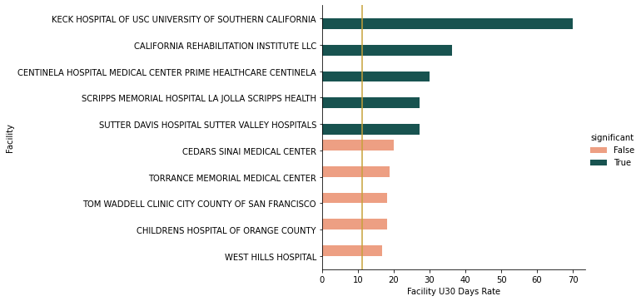
Further Segmentation
30RR (%) BY HOSPITAL
List of 10 hospitals furthest above the average 30-day readmission rate
The highest 5 are statistically significant
Only hospitals with at least 10 patient admissions are included

Slide 7
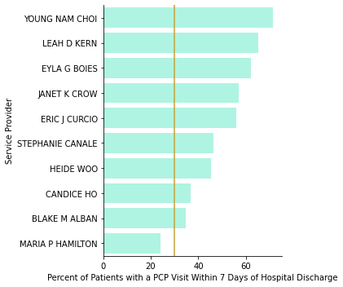
Further Segmentation
7PCPR (%) BY INDIVIDUAL PCP
Top 10 service providers based on volume of patients’ hospital admissions
Most service providers perform above the overall average 7PCPR, except for Maria P. Hamilton
Notes:
Most PCP service providers with many hospital admissions are above the overall average for 7PCPR %
Maria P Hamilton seems to need help in this area

Slide 8
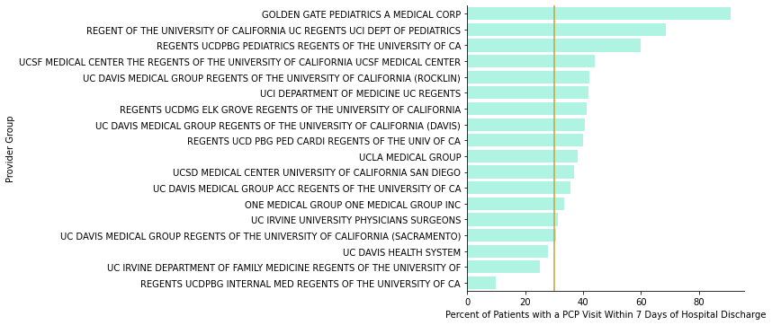
Further Segmentation
7PCPR (%) BY GROUP PCP
To focus on most visited PCP groups, only included those with 10 or more patients admitted to the hospital
Regents UCDPBG Internal Med Regents of the University of California (NPI: 1972596989) seems to need the most attention
Notes:
Most PCP groups with >10 hospital admissions are above the overall average of 7PCPR %
Regents UCDPBG seems to need help in this area

Slide 9
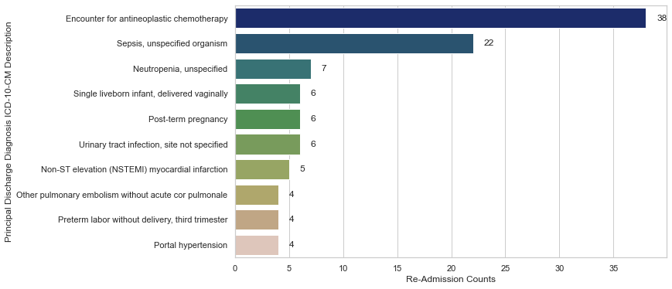
Further Segmentation
30RR (%) BY ICD-10 CODES
ICD-10 codes utilized in healthcare after OCT 2015, so this represents 72% of the readmission data within 30 days.
Neutropenia, sepsis, and chemotherapy can all be related

Slide 10
Further Segmentation
HEALTH CARE PLAN DETAILS
Plan | Average Age | Member Count | % GC Members | % GC Hosp Events | % 30RR
Bronze | 34.1 | 254 | .4% | .4% | .4%
Silver | 36.2 | 25,568 | 41.6% | 40.32% | 39.1%
Gold | 36.4 | 29,470 | 47.9% | 50.76% | 53.8%
MA | 36.2 | 6,069 | 9.8% | 8.24% | 6.1%
Medicaid | 34.2 | 158 | .25% | .27% | .4%
Gold and Silver hold the majority of GreatCare members
Age average didn’t vary much by plan
Percentages start to climb for Gold patients when looking at 30RR

Slide 11
Further Segmentation
HEALTH CARE PLAN DETAILS: DIAGNOSES & COMORBIDITIES
Plan | Ischemic Heart Disease | Anemia | Kidney Disease | Hypertension | Diabetes
Silver | 3.41% | 5.69% | 7.77% | 2.39% | 2.9%
Gold | 8.46% | 11.11% | 15.53% | 4.87% | 4.91%
% = Count of Diagnosis Code in 30RR \ Total Number of GC Members with Diagnosis
Five diagnoses among patients falling into 30RR that disproportionately favor the Gold Plan
Notes:
Add cutoff number to explain how we filtered

Slide 12
Deliverable/Intervention List
To support the Transitional Care Managers, potential interventions include:
Placing more of them at the top 10 hospitals above the average 30RR, especially those that are statistically significant.
Paying attention to the actions of the attending providers with the most patients falling into 30RR, implementing more training to correct shortcomings/oversights/mistakes.
Improving communication between individual and group PCPs that are lagging below the average 7PCPR and these TCMs.
Providing extra, more specialized care for patients with diagnoses occurring the most among unavoidable readmissions. Implementing preventive measures to ward off conditions resulting from initial diagnoses.
To develop the most effective interventions, data suggests exploring further:
More recently, hospital readmission rates seem to be increasing, while early PCP visits seem to be decreasing. Why is this?
Many individual providers seem to be performing above average. What can we learn from their practices?
The patients with the Gold plan trend higher towards specific diagnoses. What can we focus on to tailor it to address these and create a more comprehensive plan?
Notes:
Refer back to the details on the slides when going through these bullet points. 1 - (slide 6, read off top 5 statistically significant hospitals), 2 - (slide 5), 3- (Maria Hamilton, individual / UC Davis Health System, UC Irvine…, Regents UCDPGB

Slide 13
References
U.S. Centers for Medicare & Medicaid Services (2021). National Plan and Provider Enumeration System (NPPES). NPI (National Provider Identifier) Registry <retrieved from https://npiregistry.cms.hhs.gov/registry/help-api>
Ursa Health (2021). Great Care Members CSV data.
Ursa Health (2021). Hospital Inpatient CSV data.
Ursa Health (2021). Primary Care CSV data.

Slide 14
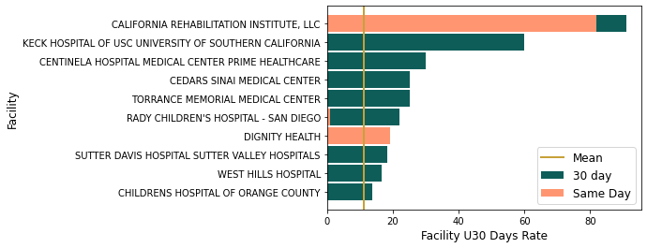
Further Segmentation
30RR (%) BY HOSPITAL
List of 10 hospitals furthest above the average 30-day readmission rate
Only hospitals with at least 10 patient admissions are included
California Rehabilitation Institute: 11 Readmissions / 10 were same-day / 7/10 by 3 attendants / 9/10 nervous system
Dignity Health: 4 Readmissions / 3/4 circulatory system
Notes:
Shows the rate of readmissions within 30 days for hospitals with more than 10 readmissions, and the subsection that were readmitted within the same day.
Remember to mention the 0000000000 Facility. → Data integrity

Slide 15
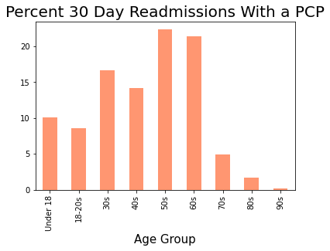
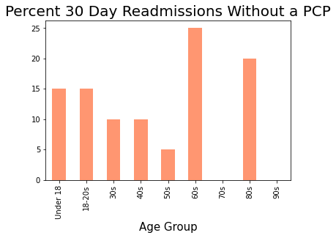
Further Segmentation
PATIENTS WITH NO ASSIGNED PCP OR NO RECENT VISIT
NUMBERS
GRAPH
Insights to Note:
Notes:
What do we want to show here? Any insights?
Target younger patients to encourage them to choose a PCP.
Age groups to reach out to make yearly appointment?
percent of patients that do not have a PCP =18%

